Slide 1
PROJECT REPORT BCA - Data Science | Sem 6 | Nov-Dec 2025
Name : SURAJ RAVISHANKAR YADAV Reg. No. : EC2331201010110
Under the Guidance of Prof. Muthuselvam

Slide 2
Topic
Internet Downtime Prediction Web APP using Python, Machine Learning, GitHub & Streamlit

Slide 3
Abstract
The Internet Downtime Prediction project aims to develop a machine learning based web application capable of predicting the severity of internet downtime for Internet Service Providers (ISPs). Maintaining consistent network connectivity is a critical challenge for ISPs, as frequent or prolonged downtimes lead to customer dissatisfaction, service complaints, and potential revenue loss.
This project leverages supervised machine learning techniques to predict downtime categories - Low, Moderate, or High, based on key network performance indicators such as download speed, upload speed, latency, jitter, and packet loss, along with regional and environmental factors like city, locality, and weather conditions.
The dataset was pre-processed through encoding of categorical variables and scaling of numerical features to ensure balanced input for the model. Various classification algorithms were trained and evaluated, including Logistic Regression, Decision Tree, Random Forest, Gradient Boosting, K-Nearest Neighbors, and Support Vector Machine (SVM). Among these, the Random Forest Classifier demonstrated the best performance with an accuracy of 92.00%, making it the chosen model for deployment.
The trained model was serialized using the joblib library and integrated into an interactive web application built with Streamlit, allowing users to input network and environmental parameters to predict the expected downtime category. This system enables ISPs to proactively monitor network conditions, identify high risk zones, and take preventive measures to reduce severe service disruptions.
In conclusion, the Internet Downtime Prediction project demonstrates the effective application of machine learning in network reliability management, offering a practical tool for improving service quality and customer experience.

Slide 4
Tools & Technologies
Python
NumPy
Pandas
Seaborn
Matplotlib
Scikit-learn
Anaconda Navigator
Jupyter Notebook
Excel
Machine learning algorithms
Logistic Regression
Decision Tree Classifier
Random Forest Classifier
Gradient Boosting Classifier
K-Nearest Neighbors Classifier
Support Vector Classifier (SVC)
Github
Streamlit
Notepad++

Slide 5
implementation
Problem Statement
Data Understanding
Importing Libraries
Loading the dataset
Exploratory Data Analysis
Data Visualization
Data Cleaning
Feature Selection
Train-Test Split
Feature Scaling
Modeling Training
Model Performance
Performance Analysis
Saving Model
Loading Model
User Interface Design
Testing
Deployment
Result
Conclusion

Slide 6
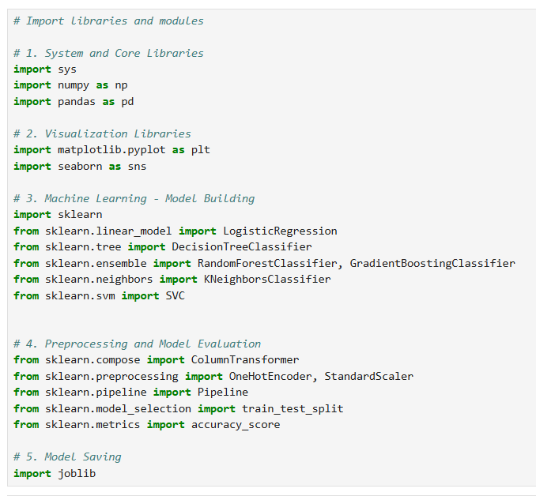
Importing Libraries

Slide 7
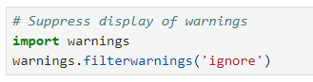
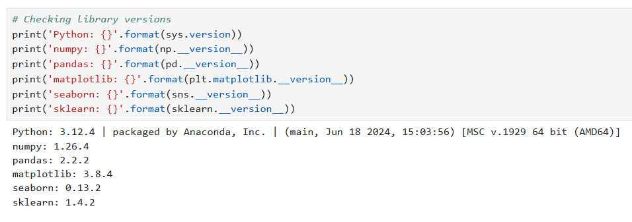
Suppressing Warnings
Library Versions

Slide 8
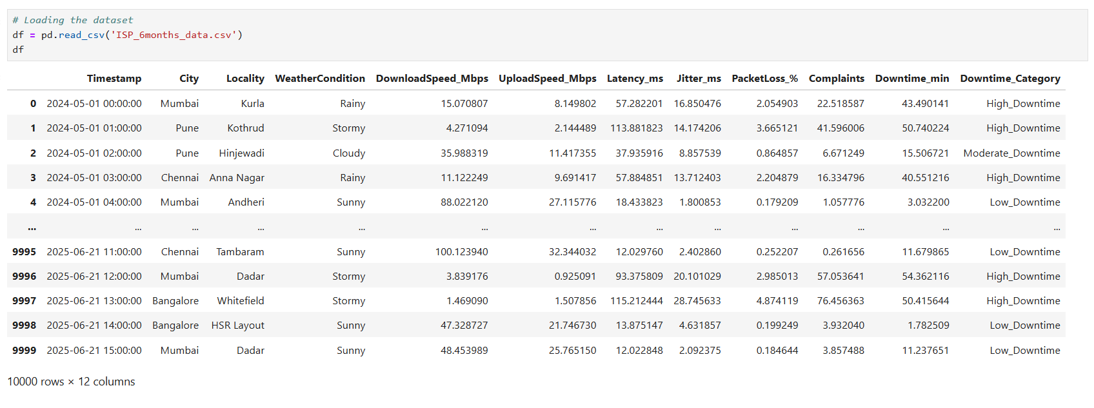
Loading dataset

Slide 9
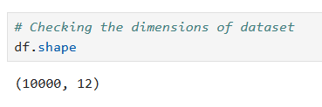
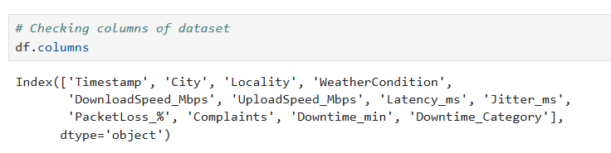
Exploratory Data Analysis (EDA)
Checking Dimensions
Checking Columns

Slide 10
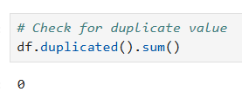
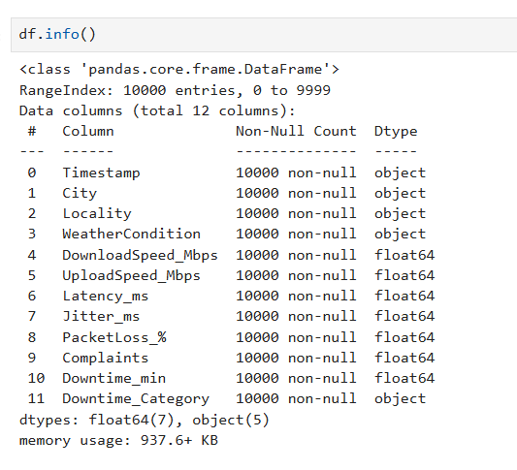
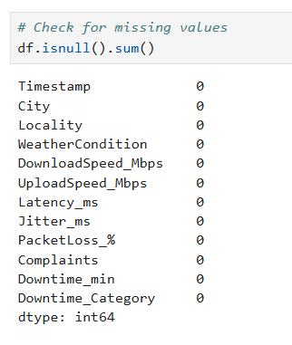
Duplicate Values
Summary of Dataset
NULL Values

Slide 11
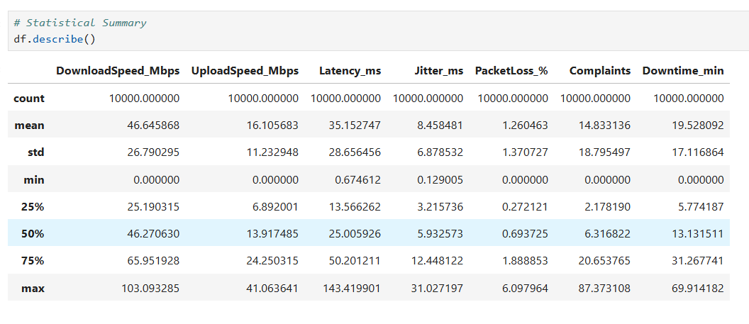
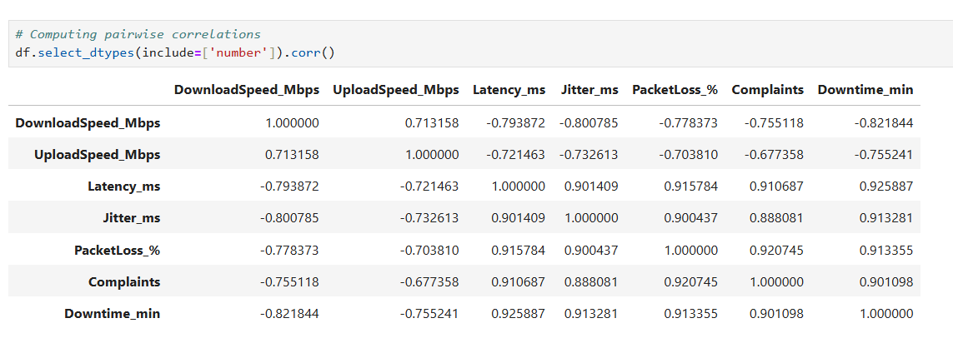
Descriptive Statistics
Pairwise Correlations

Slide 12
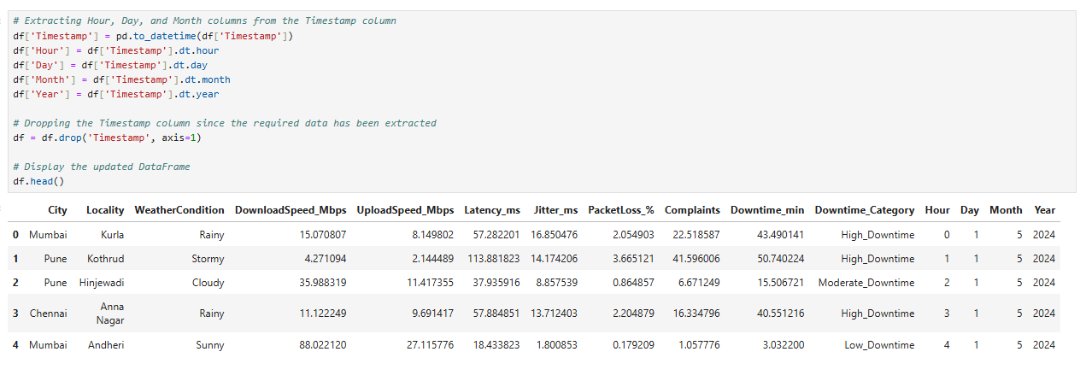
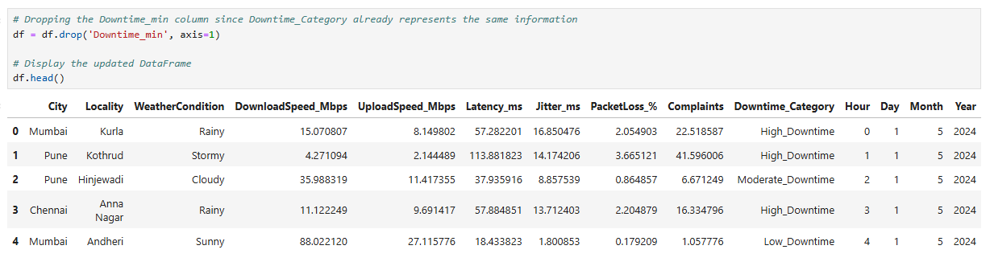
Extracting Date-Time Features
Dropping Unnecessary Columns

Slide 13
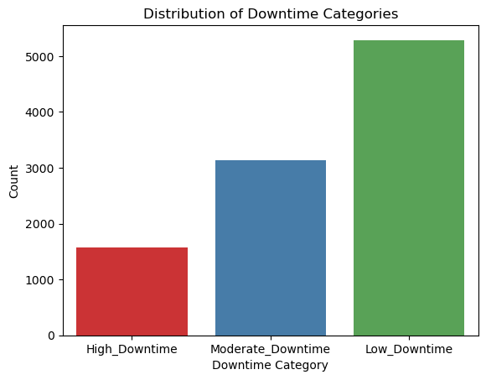
Count plot
Conclusion:
The bar chart displays the distribution of High_Downtime, Moderate_Downtime, and Low_Downtime categories.
The Low_Downtime category has the highest number of records in the dataset.
The Moderate_Downtime category appears with a moderate frequency.
The High_Downtime category has the lowest count among all.
This indicates that most observations experience low downtime, suggesting stable network performance in general.
Although there is a visible class imbalance, it has been kept as it is to reflect the dataset’s real-world scenario without altering the natural distribution of downtime occurrences.

Slide 14
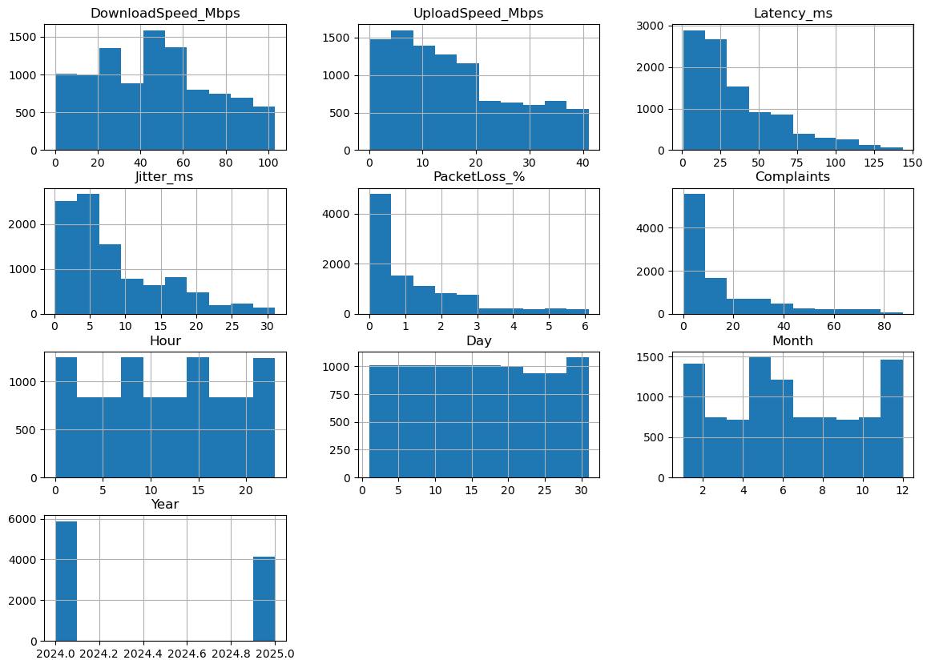
Histograms: Distribution of Numerical Features
Conclusion:
The histograms display the distribution of all numerical variables in the dataset, such as network speed, latency, jitter, packet loss, and temporal features.
DownloadSpeed_Mbps and UploadSpeed_Mbps show moderately uniform distributions, indicating varying internet speeds among users.
Latency_ms, Jitter_ms, PacketLoss_%, and Complaints are right-skewed, showing that most observations have low values while a few have very high values (possible outliers).
Hour, Day, and Month are evenly spread, suggesting data is well-distributed across different time periods.
The Year variable mainly covers 2024 and 2025, indicating data collected over two years.
Overall, the dataset contains a mix of continuous and temporal features with some skewness in performance-related metrics, which should be considered during model training and scaling.

Slide 15
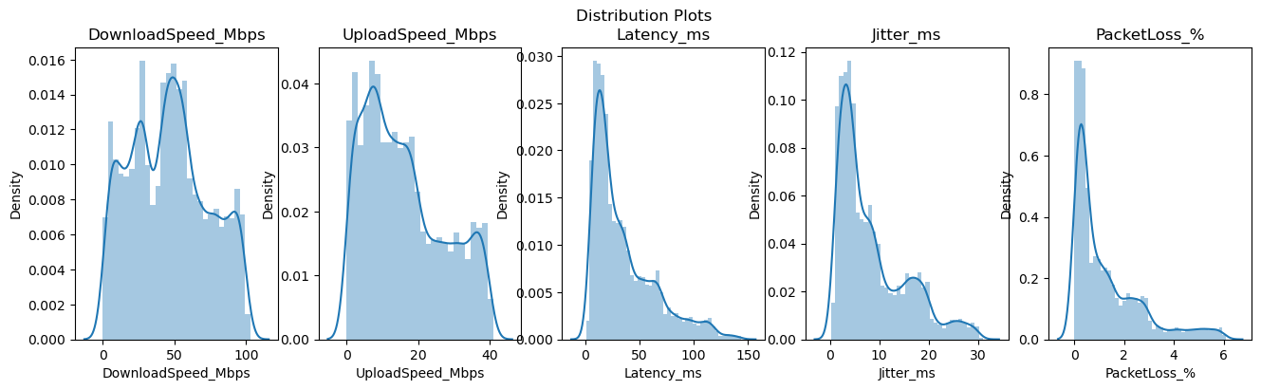
Distribution Plots: Network Performance Metrics
Conclusions:
The plots display the distribution of continuous variables such as DownloadSpeed_Mbps, UploadSpeed_Mbps, Latency_ms, Jitter_ms, and PacketLoss_%.
DownloadSpeed_Mbps and UploadSpeed_Mbps show a fairly bimodal distribution, indicating that users experience two distinct ranges of internet speeds.
Latency_ms, Jitter_ms, and PacketLoss_% are right-skewed, showing that most observations have low values, while a few have high values — representing occasional poor network performance.
The peaks near lower values in latency, jitter, and packet loss suggest that network conditions are generally stable for most users.
Overall, the data distributions indicate that the majority of users experience good network quality, but there are instances of high latency and packet loss that may cause downtime or reduced performance.

Slide 16
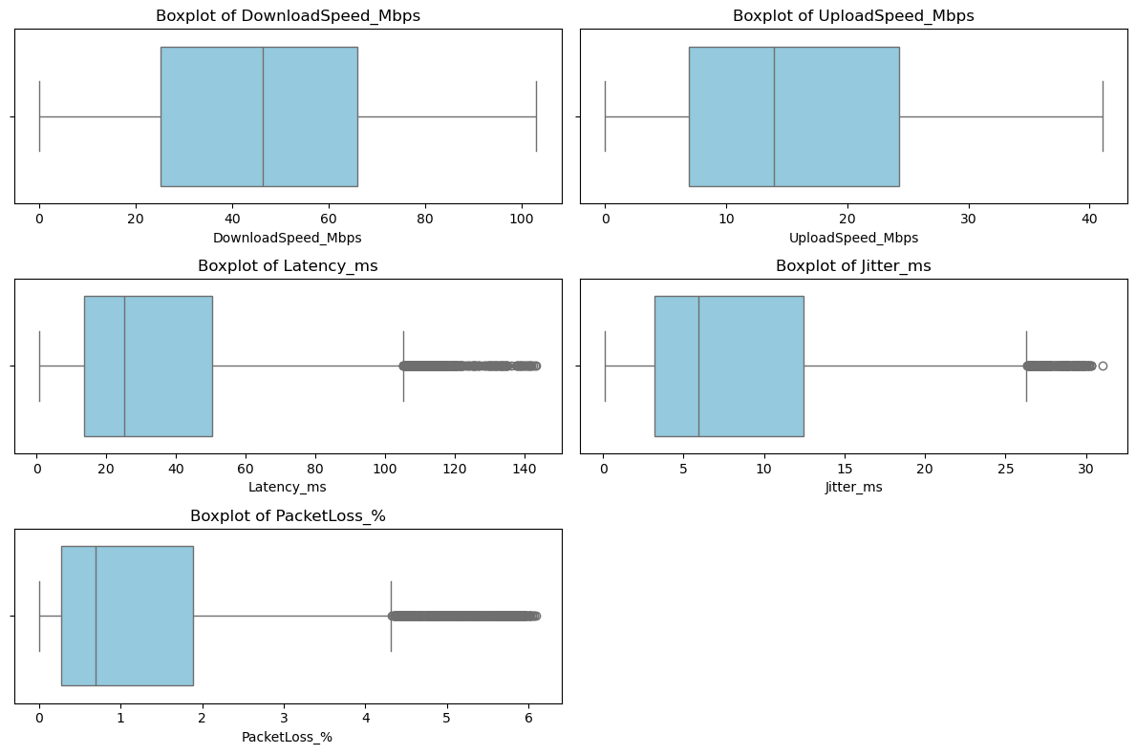
Boxplots: Network Performance Metrics
Conclusion:
The boxplots represent the spread and presence of outliers in key numerical variables such as DownloadSpeed_Mbps, UploadSpeed_Mbps, Latency_ms, Jitter_ms, and PacketLoss_%.
DownloadSpeed_Mbps and UploadSpeed_Mbps show a fairly symmetric distribution with few or no extreme outliers, indicating stable internet speed values.
Latency_ms, Jitter_ms, and PacketLoss_% contain several outliers on the higher side, showing occasional spikes in delay, jitter, and packet loss.
The median values of these variables lie toward the lower end, suggesting that most users experience good network performance most of the time.
The presence of high-end outliers may correspond to rare instances of poor network conditions or high downtime events.
Overall, the boxplots highlight that while the network performance is generally consistent, some extreme values exist that could influence model training if not properly handled.

Slide 17
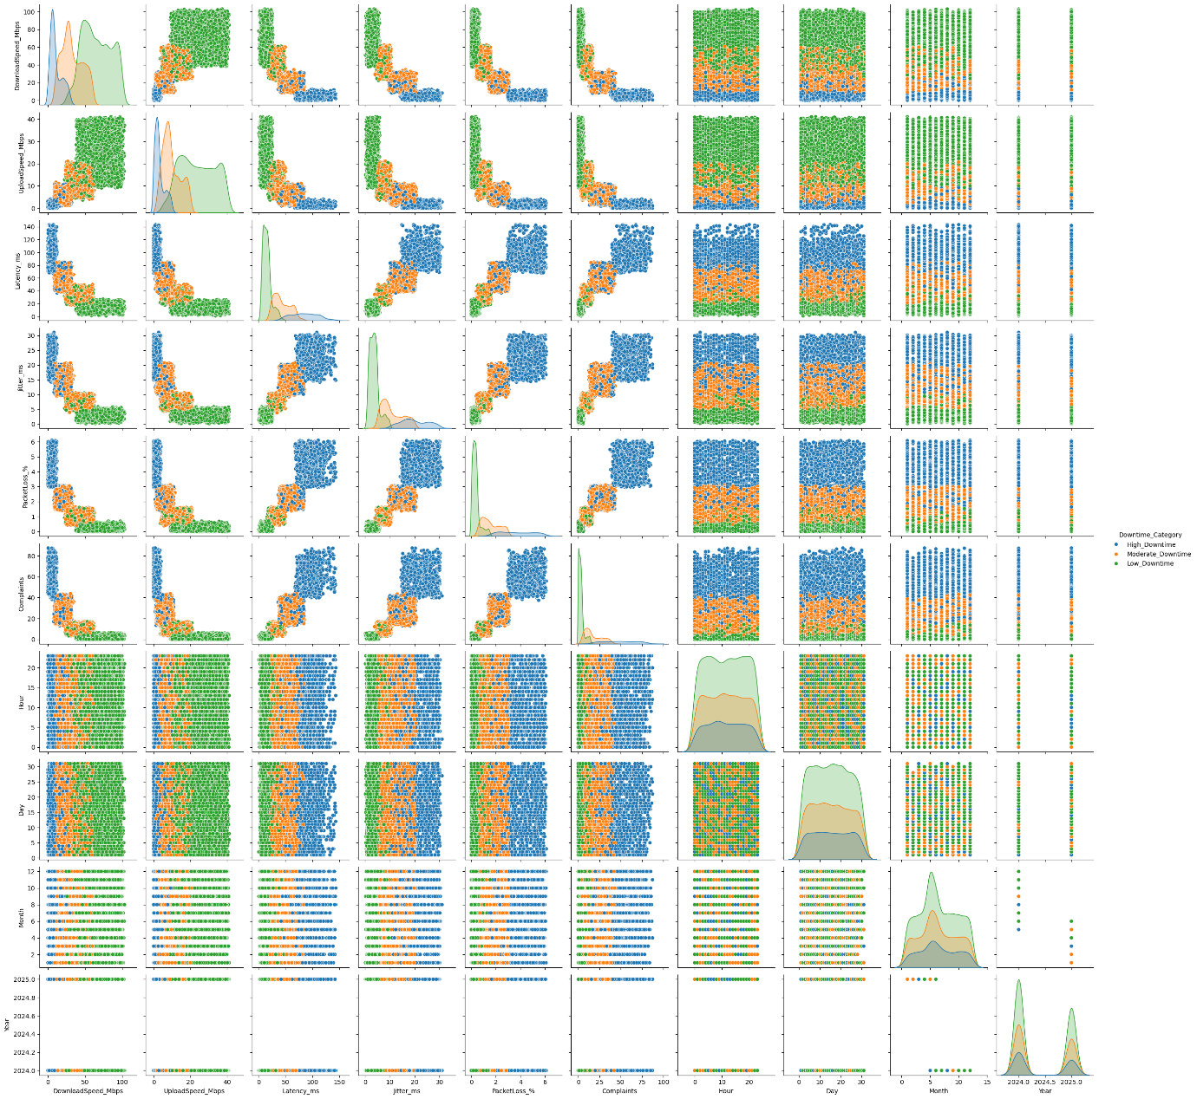
Features Pairplot
Conclusion:
The pairplot visualizes the relationships between multiple numerical features such as DownloadSpeed_Mbps, UploadSpeed_Mbps, Latency_ms, Jitter_ms, PacketLoss_%, and others, categorized by different Downtime levels (High, Moderate, and Low).
There is a clear trend where Low_Downtime points (green) are generally associated with higher download and upload speeds and lower latency, jitter, and packet loss.
In contrast, High_Downtime points (red) are more concentrated in regions with low speeds and high latency/jitter, indicating poorer network performance.
Moderate_Downtime points (orange) lie between the two, showing intermediate performance levels.
The plots confirm that network performance metrics are strongly related to downtime categories, supporting their importance as predictive features.
No strong linear relationships are visible among all features, suggesting that non-linear models (like Random Forest or XGBoost) may perform better.
Overall, the pairplot highlights clear separation patterns between classes, helping in understanding how performance metrics influence downtime classification.

Slide 18
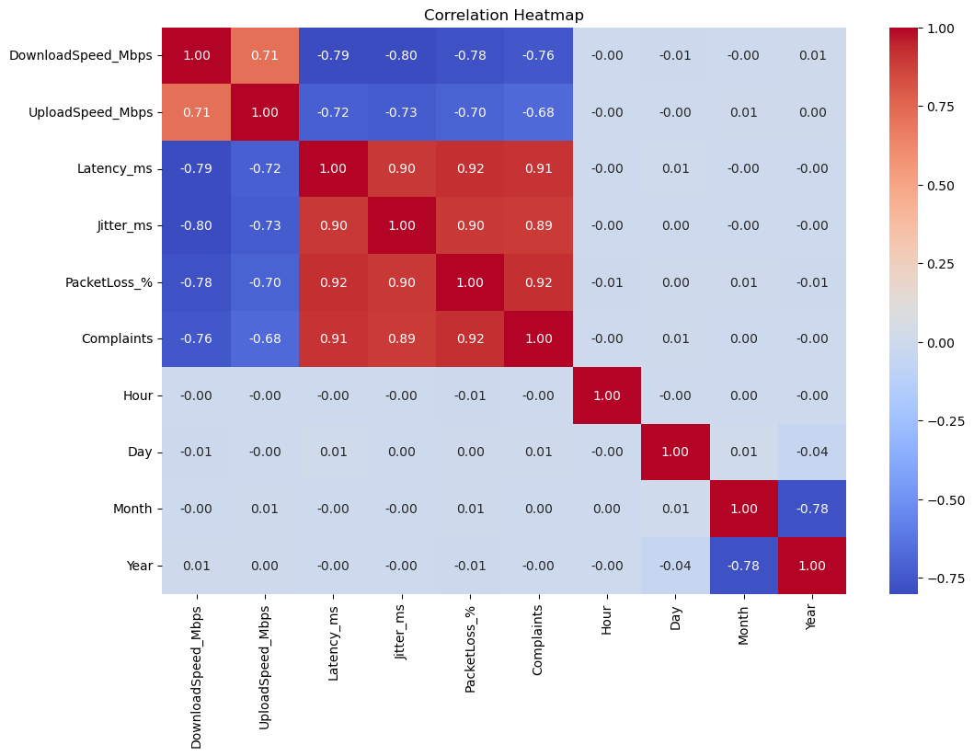
Correlation Heatmap
Conclusion:
Strong Performance Link: Performance metrics like Latency, Jitter, PacketLoss_%, and Complaints are highly inter-correlated (0.90 to 0.93). They all collectively increase when the network is poor.
Inverse Speed Relationship: DownloadSpeed and UploadSpeed are strongly negatively correlated (around -0.70 to -0.80) with all the poor performance indicators. High speed means low latency and few complaints, and vice-versa.
Feature Importance: The most critical features for predicting downtime are the Latency, Jitter, and Packet Loss cluster. Their high multicollinearity suggests they represent a single underlying state of poor network quality.
Temporal Features: Hour and Day are not significant linear predictors of downtime, indicating the cause of poor service is independent of the time of day.

Slide 19
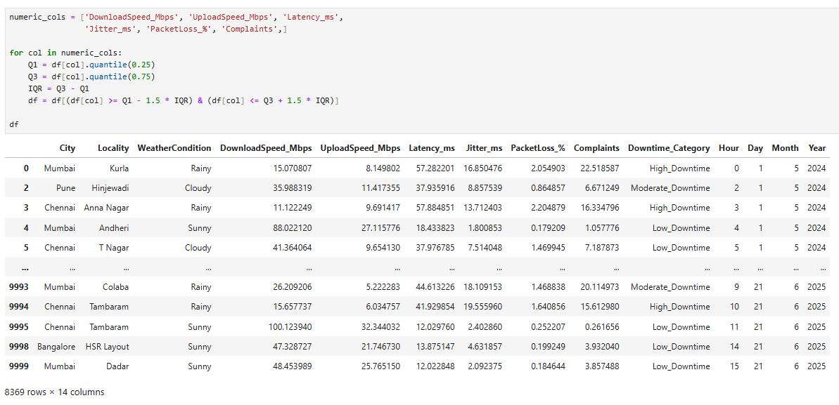
Handling Outliers
Conclusions:
The code removes outliers from the numerical columns (DownloadSpeed_Mbps, UploadSpeed_Mbps, Latency_ms, Jitter_ms, PacketLoss_%, Complaints) using the IQR method.
Values outside 1.5×IQR from Q1 and Q3 are filtered out to reduce extreme deviations.
After outlier removal, the dataset has 8,369 rows and 14 columns, ensuring cleaner data for modeling.
This helps improve model accuracy and robustness by reducing the effect of extreme values.

Slide 20
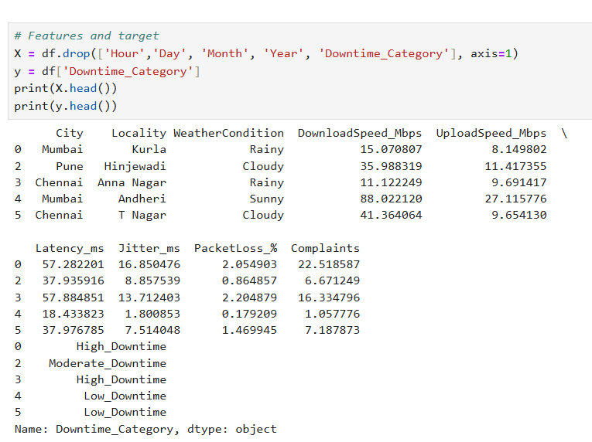
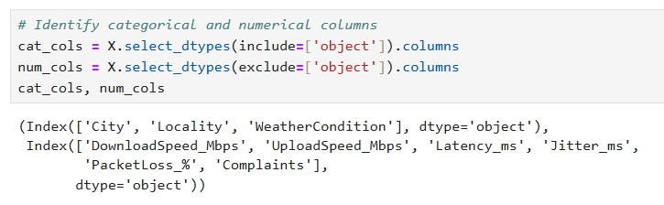
Feature and Target Selection
The dataset is split into features (X) and target (y) for modeling.
Features (X) include network metrics, environmental factors, and location information: City, Locality, WeatherCondition, DownloadSpeed_Mbps, UploadSpeed_Mbps, Latency_ms, Jitter_ms, PacketLoss_%, and Complaints
Target (y) is the Downtime_Category, representing the severity of internet downtime (Low_Downtime, Moderate_Downtime, High_Downtime).
This separation prepares the data for machine learning model training and evaluation.
Identifying Column Types

Slide 21
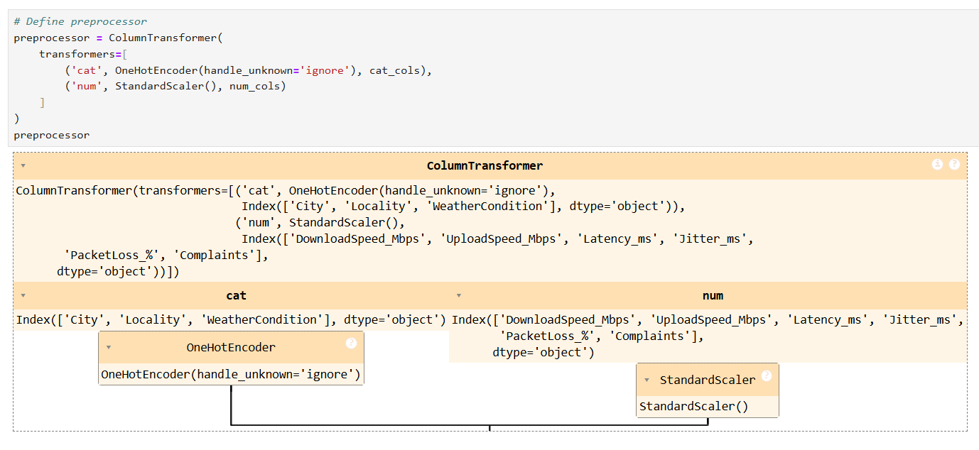
Preprocessor
Conclusions:
A ColumnTransformer is defined to preprocess the dataset before model training.
Categorical features (City, Locality, WeatherCondition) are transformed using OneHotEncoder to convert them into numerical format.
Numerical features (DownloadSpeed_Mbps, UploadSpeed_Mbps, Latency_ms, Jitter_ms, PacketLoss_%, Complaints) are scaled using StandardScaler to standardize their values.
This preprocessing ensures that all features are in a suitable format and scale for machine learning algorithms.

Slide 22
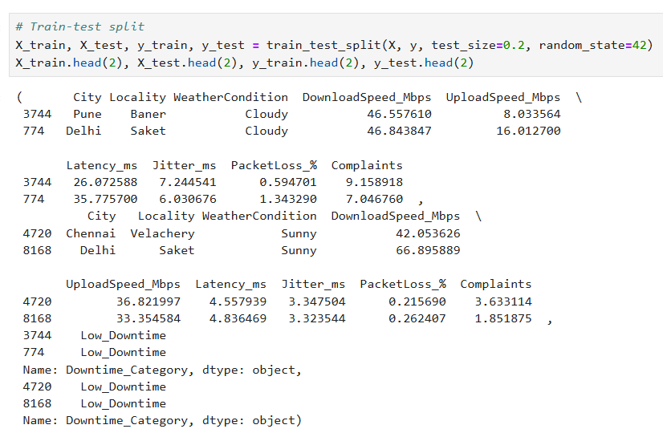
Train-Test Split

Slide 23
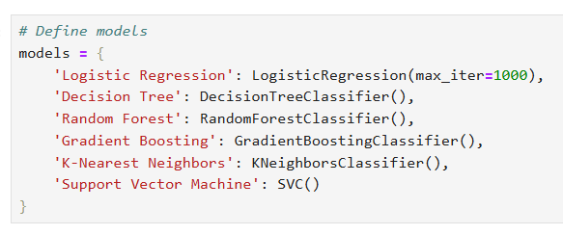
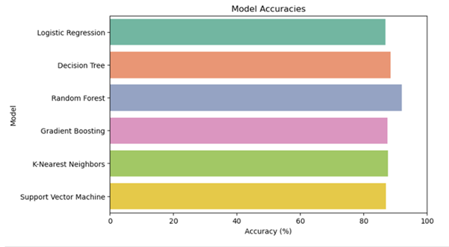
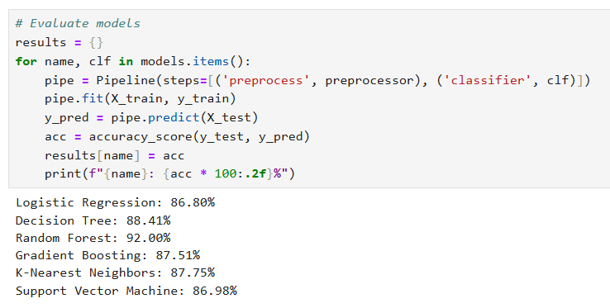
Define Models
Visualize Model Accuracy
Evaluate Models

Slide 24
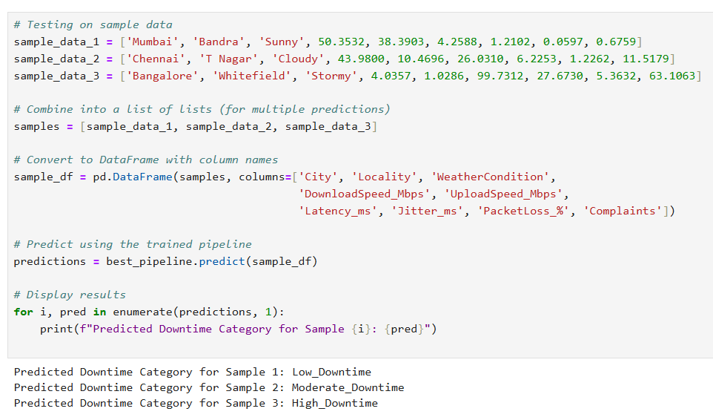
Testing

Slide 25
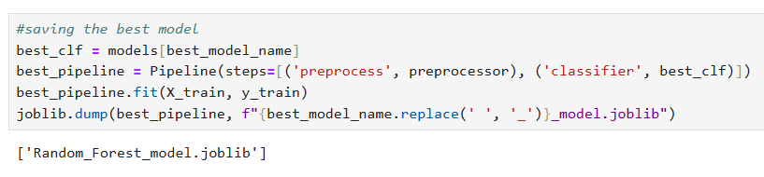
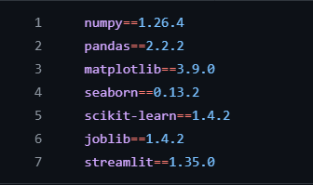
Saving Model
requirements.txt

Slide 26
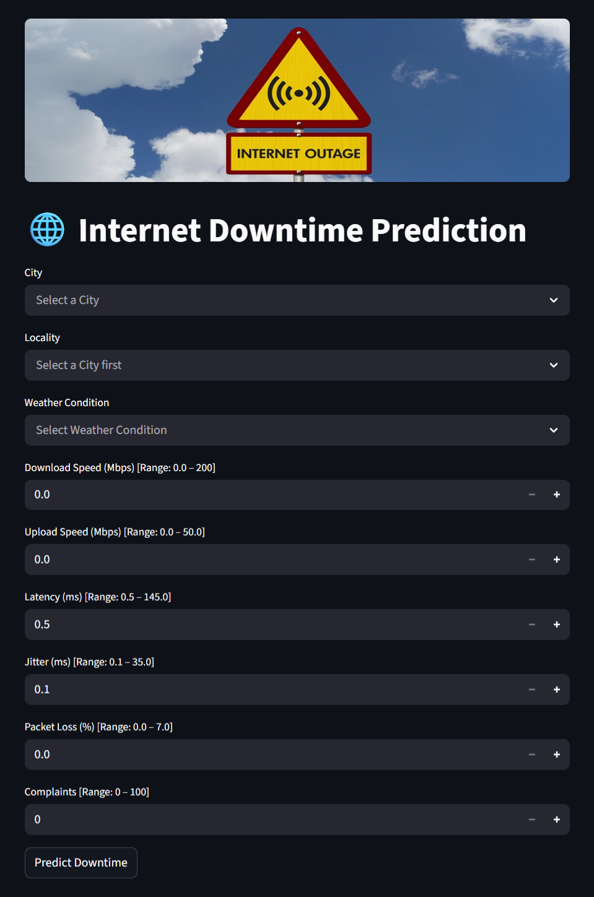
Result
Internet Downtime Prediction
Streamlit Web APP
Homepage

Slide 27
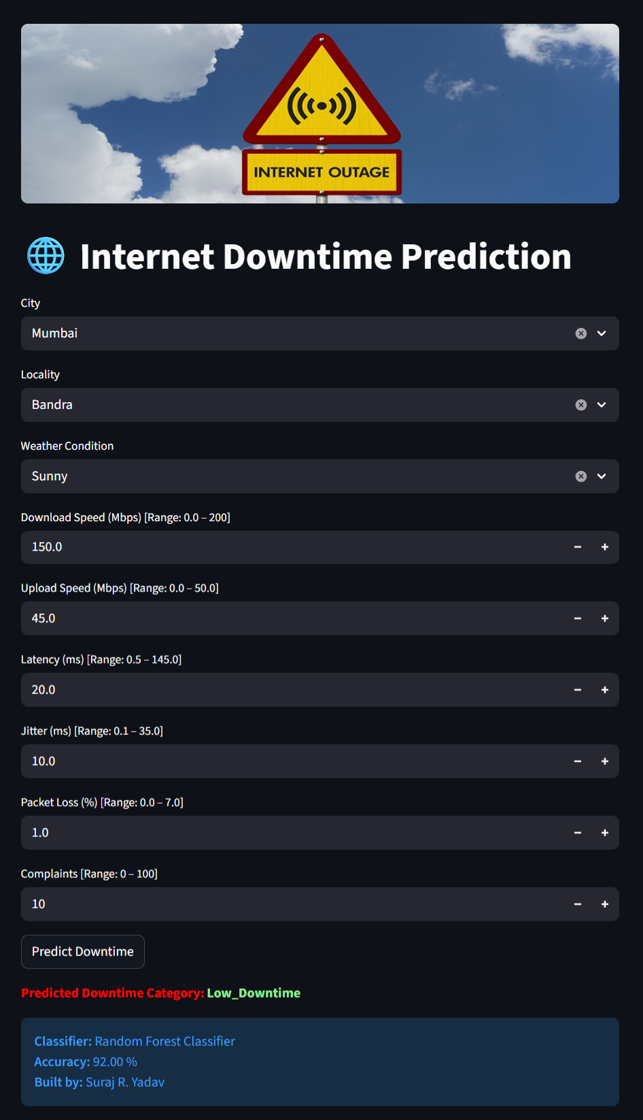
Internet Downtime Prediction
Sample 1
Output: Low_Downtime

Slide 28
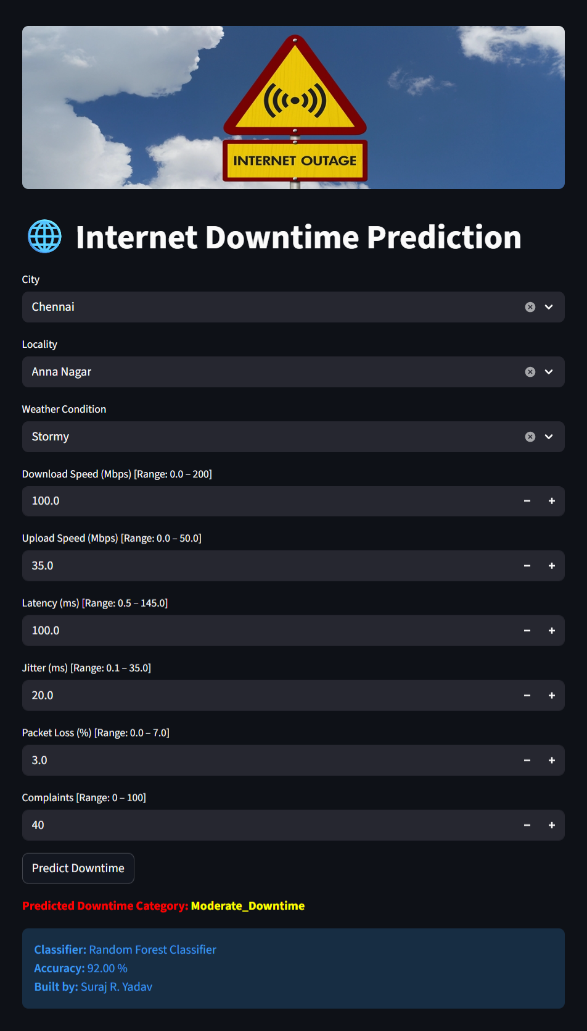
Internet Downtime Prediction
Sample 2
Output: Moderate_Downtime

Slide 29
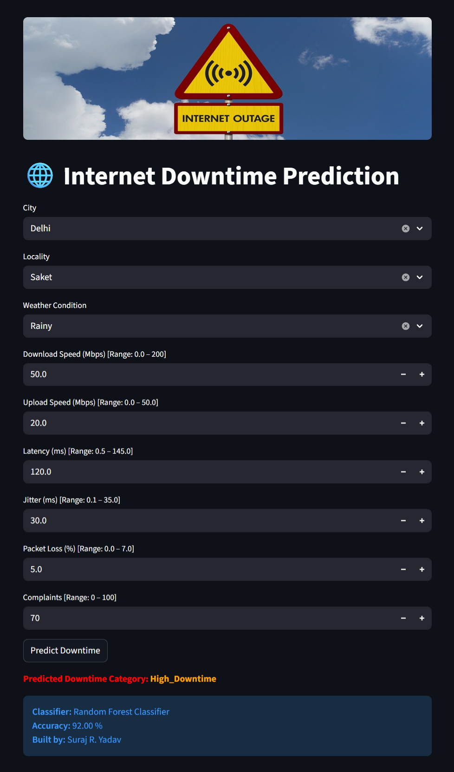
Internet Downtime Prediction
Sample 3
Output: High_Downtime

Slide 30


Streamlit Web APP link : https://internet-downtime-prediction.streamlit.app/ GitHub Project link : https://github.com/sryagit/Internet_Downtime_Prediction

Slide 31
Conclusion
The Internet Downtime Prediction project aimed to develop a machine learning-based system capable of predicting the severity of internet downtime for Internet Service Providers (ISPs). Predicting network disruptions is crucial, as frequent or prolonged downtimes can lead to customer dissatisfaction, service complaints, and potential revenue loss.
In this project, key network performance indicators—such as download speed, upload speed, latency, jitter, and packet loss—along with regional and environmental factors like city, locality, and weather conditions, were used as features. The dataset was preprocessed by encoding categorical variables and scaling numerical features to ensure optimal performance for the models.
Several classification algorithms were implemented and evaluated, including Logistic Regression, Decision Tree, Random Forest, Gradient Boosting, K-Nearest Neighbors, and Support Vector Machine (SVM). Among these, the Random Forest Classifier achieved the highest accuracy of 92%, making it the most suitable model for deployment. The model was serialized using joblib and integrated into a Streamlit web application, allowing users to input network and environmental parameters to predict the expected downtime category: Low, Moderate, or High.
Overall, this project demonstrates the practical application of machine learning in network reliability management. It provides ISPs with a proactive tool to monitor network conditions, identify high-risk zones, and take preventive actions to reduce severe service disruptions, ultimately improving service quality and customer experience.

